Slide 1
Java Lang Package
Fresher Learning Program January, 2013
Notes:
© 2006 Capgemini - All rights reserved

Slide 2
Objectives of Java Lang Package
Purpose:
  To understand important classes under Java Lang package like String, Math, Wrapper classes, StringBuffer / StringBuilder, and System Classes.
Product:
  Understanding of String class and its immutableness
  Understanding of all Wrapper classes, their usage and how to use
  Understanding of System class, its use and how to use
  Understanding of Math class, its use and how to use
Process:
  Theory Sessions along with assignments
  A recap at the end of the session in the form of Quiz.
© 2013 Capgemini - All rights reserved
Notes:
© 2006 Capgemini - All rights reserved

Slide 3
Table of Contents
Math Class
String and the StringBuffer, StringBuilder Class
Wrapper Classes
System Class
© 2013 Capgemini - All rights reserved

Slide 4
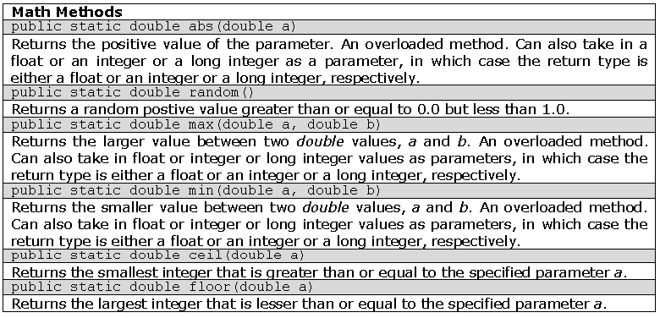
The Math Class
Provides predefined constants and methods for performing different mathematical operations
Methods:
© 2013 Capgemini - All rights reserved
Notes:
Ver 1.0 © 2006 Capgemini - All rights reserved

Slide 5
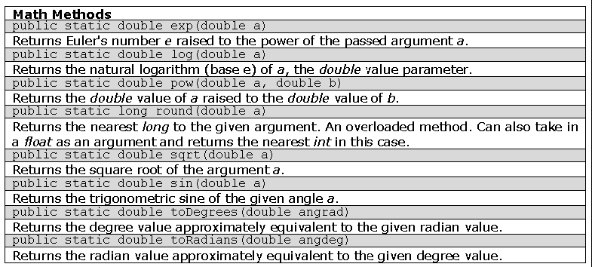
The Math Class: Methods
© 2013 Capgemini - All rights reserved
Notes:
Ver 1.0 © 2006 Capgemini - All rights reserved

Slide 6
The Math Class: Example
class MathDemo {
  public static void main(St ring args[]) {
    System.out.println("absolute value of -5: " + Math.abs(-5));
    System.out.println("absolute value of 5: " + Math.abs(-5));
    System.out.println("random number(max is 10):" + Math.random()*10) ;
    System.out.println("max of 3.5 and 1.2: " + Math.max(3.5,1.2));
    System.out.println("min of 3.5 and 1.2: " + Math.min(3.5,1.2));
    System.out.println("ceiling of 3.5: " + Math.ceil(3.5));
    System.out.println("floor of 3.5: " + Math.floor(3.5));
    System.out.println("e raised to 1: " + Math.exp(1));
    System.out.println("log 10: " + Math.log(10));
    System.out.println("10 raised to 3: " + Math.pow(10,3));
    System.out.println("rounded off value of pi: " + Math.round(Math.PI));
    System.out.println("square root of 5 = " + Math.sqrt(5));
    System.out.println("10 radian = " + Math.toDegrees(10) + " degrees");
    System.out.println("sin(90): " + Math.sin(Math.toRadians(90)));
  }
}
© 2013 Capgemini - All rights reserved
Notes:
Ver 1.0 © 2006 Capgemini - All rights reserved

Slide 7
String Class
Definition:
– Represents combinations of character literals
– Using Java, strings can be represented using:
Array of characters
The String class
– Note: A String object is different from an array of characters!
String constructors
– 13 constructors
© 2013 Capgemini - All rights reserved
Notes:
Ver 1.0 © 2006 Capgemini - All rights reserved

Slide 8
The String Class: Constructors
class StringConstructorsDemo {
  public static void main(String args[]) {
    String s1 = new String(); //empty string
    char chars[] = { 'h', 'e', 'l', 'l', 'o'};
    String s2 = new String(chars); //s2="hello";
    byte bytes[] = { 'w', 'o', 'r', 'l', 'd' };
    String s3 = new String(bytes); //s3="world"
    String s4 = new String(chars, 1, 3);
    String s5 = new String(s2);
    String s6 = s2;
    System.out.println(s1);
    System.out.println(s2);
    System.out.println(s3);
    System.out.println(s4);
    System.out.println(s5);
    System.out.println(s6);
  }
  }
© 2013 Capgemini - All rights reserved
Notes:
Ver 1.0 © 2006 Capgemini - All rights reserved

Slide 9
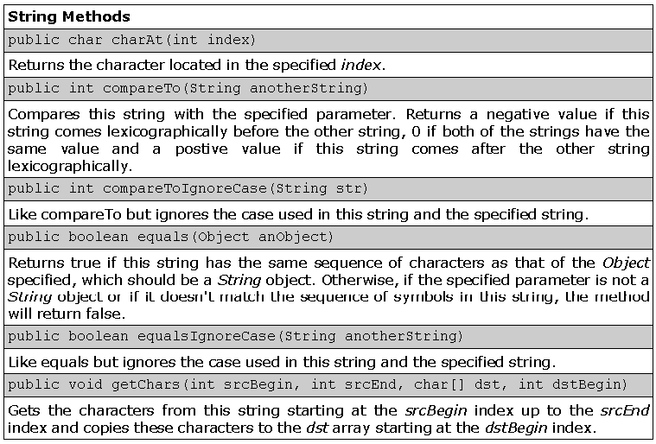
The String Class: Methods
© 2013 Capgemini - All rights reserved
Notes:
Ver 1.0 © 2006 Capgemini - All rights reserved

Slide 10
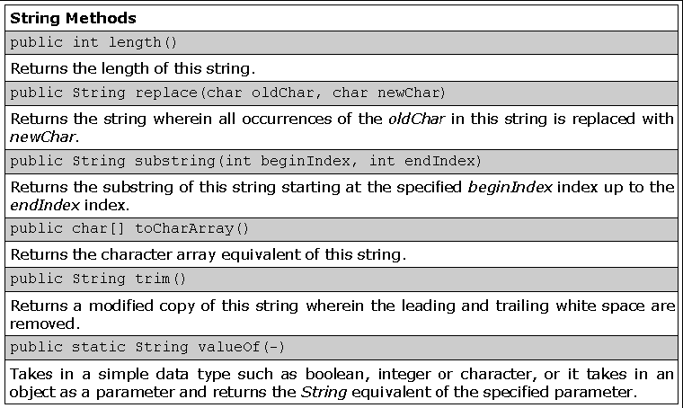
The String Class: Methods
© 2013 Capgemini - All rights reserved
Notes:
Ver 1.0 © 2006 Capgemini - All rights reserved

Slide 11
The StringBuffer Class
Problem with String objects:
– Once created, can no longer be modified (It is a final class)
A StringBuffer object
– Similar to a String object
– But, mutable or can be modified
● Unlike String in this aspect
● Length and content may changed through some method calls
© 2013 Capgemini - All rights reserved
Notes:
Ver 1.0 © 2006 Capgemini - All rights reserved

Slide 12
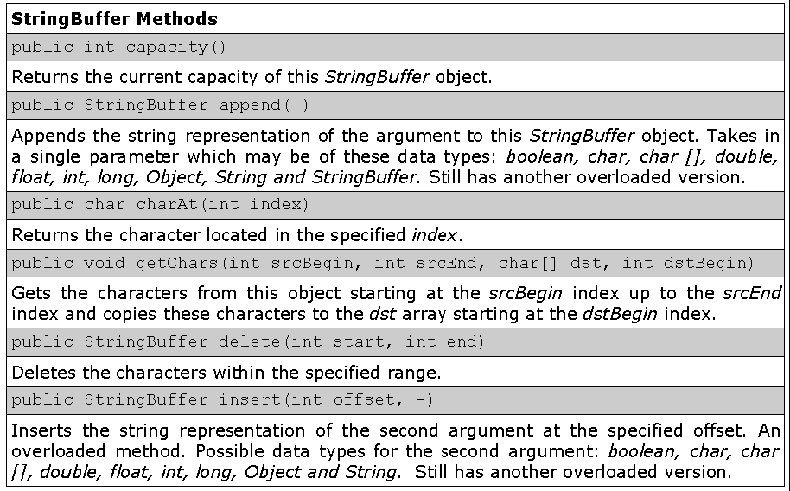
The StringBuffer Class: Methods
© 2013 Capgemini - All rights reserved
Notes:
Ver 1.0 © 2006 Capgemini - All rights reserved

Slide 13
The StringBuilder Class
StringBuilder class is same as StringBuffer.
Only difference is that StringBuffer is thread Safe.
In general – it is better to use StringBuilder, until thread safety is concerned.
© 2013 Capgemini - All rights reserved
Notes:
Ver 1.0 © 2006 Capgemini - All rights reserved

Slide 14
The Wrapper Classes
Some Facts:
Primitive data types are not objects
Cannot access methods of the Object class
Only actual objects can access methods of the Object class
Why wrapper classes?
Need an object representation for the primitive type variables to use Java built-in methods
Definition: Object representations of simple non-object variables
© 2013 Capgemini - All rights reserved
Notes:
Ver 1.0 © 2006 Capgemini - All rights reserved

Slide 15
The Wrapper Class
Wrapper classes are very similar to their primitive equivalents.
– Capitalized
– Spelled out versions of the primitive data types
© 2013 Capgemini - All rights reserved
Notes:
Ver 1.0 © 2006 Capgemini - All rights reserved

Slide 16
Wrapper Classes
It converts primitive values to objects.
Need of Wrapper class:
Primitive values in java are not objects. So in order to include the primitives in the activities reserved for objects for ex-to be used as elements of Collections or to be returned as objects from a method we need Wrapper classes.
There is a Wrapper class for every primitive in java.
All Wrapper classes are final.
The objects of all Wrapper classes are immutable i.e their state can not be changed
© 2013 Capgemini - All rights reserved
Notes:
Ver 1.0 © 2006 Capgemini - All rights reserved

Slide 17
The Wrapper Class: Example
PrimitiveType Corresponding Wrapper class
boolean Boolean
byte Byte
char Character
double Double
float Float
int Integer
long Long
short Short
© 2013 Capgemini - All rights reserved
Notes:
Ver 1.0 © 2006 Capgemini - All rights reserved

Slide 18
Numeric Wrapper Classes
Each numeric Wrapper classdefines minimum and maximum value of the corresponding primitive data type.
<Wrapperclassname>.MIN_VALUE
<Wrapperclassname>.MAX_VALUE
Example -
int max = Integer.MAX_VALUE
double max = Double.MIN_VALUE
© 2013 Capgemini - All rights reserved
Notes:
Ver 1.0 © 2006 Capgemini - All rights reserved

Slide 19
Creating Wrapper Objects
By using Constructors : ( converting primitive values to wrapper objects)
Character c1 = new Character(‘c’);
Boolean b1 = new Boolean(true);
Integer i1 = new Integer(8000);
Double d1 = new Double(8.34);
© 2013 Capgemini - All rights reserved
Notes:
Ver 1.0 © 2006 Capgemini - All rights reserved

Slide 20
Creating Wrapper Objects
B(converting Strings to Wrapper objects)
Boolean b2 = new Boolean(“TrUe”); // true
Boolean b3 = new Boolean(“xx”); //false
Integer i2 = new Integer(“8000”);
Double d2 = new Double(“8.45”);
Long long1 = new Long(8);
© 2013 Capgemini - All rights reserved
Notes:
Ver 1.0 © 2006 Capgemini - All rights reserved

Slide 21
Using Wrapper conversion utilities
1.Converting Wrapper objects to Strings
String toString()
Each Wrapper classoverrides the toString() method from the Object class.
Character c1 = new Character('g');
String s1 = c1.toString();
Boolean b1 = new Boolean(true);
String s2 = b1.toString();
© 2013 Capgemini - All rights reserved
Notes:
Ver 1.0 © 2006 Capgemini - All rights reserved

Slide 22
Using Wrapper conversion…
2.Converting primitive values to Strings
Each wrapper class defines a static method toString(type v) that returns the String corresponding to the primitive value .
static String toString(type v)
String s1 = Character.toString('\n');
String s2 = Boolean.toString(false);
String s3 = Integer.toString(2000);// base 10
String s4 = Double.toString(1.55);
© 2013 Capgemini - All rights reserved
Notes:
Ver 1.0 © 2006 Capgemini - All rights reserved

Slide 23
Using Wrapper conversion…
3. Converting integer values to Strings in different Notations
static String toBinaryString(int i) //base 2
static String toHexString(int i) //base 16
static String toOctalString(int i) //base 8
These three methods return an unsigned String value of base 2,16,8 with no leading zeros.
static String toString(int i, int base)
This method returns the minus sign('-') as the first character if i is negative.
static String toString(int i)
© 2013 Capgemini - All rights reserved
Notes:
Ver 1.0 © 2006 Capgemini - All rights reserved

Slide 24
Using Wrapper conversion…
4. Converting Wrapper objects to primitive values
Each Wrapper classexcept Boolean and Character defines a typeValue() which returns the primitive value in the wrapper object.
type typeValue()
double d = d1.doubleValue();
int i = i1.intValue();
© 2013 Capgemini - All rights reserved
Notes:
Ver 1.0 © 2006 Capgemini - All rights reserved

Slide 25
Using Wrapper conversion…
5. Converting any numeric Wrapper objects into any numeric primitive values
Byte b1 = new Byte((byte)17);
Integer i1 = new Integer(2005);
Double d1 = new Double(1.48);
short s1 = i1.shortValue();
long l1 = b1.longValue();
int i2 = d1.intValue(); //truncation
double d2 = i1.doubleValue();
© 2013 Capgemini - All rights reserved
Notes:
Ver 1.0 © 2006 Capgemini - All rights reserved

Slide 26
Using Wrapper conversion…
6. Converting Strings to Numeric values
Each numeric wrapper classdefines a static method parseType(String s) that returns the primitive numeric value of String it contains.
This method will throw a NumberFormatException if the String parameter is not a valid argument.
© 2013 Capgemini - All rights reserved
Notes:
Ver 1.0 © 2006 Capgemini - All rights reserved

Slide 27
Using Wrapper conversion…
1. static type parseType(String s)
byte b1 = Byte.parseByte("18");
int i1 = Integer.parseInt("2007");
int i2 = Integer.parseInt("abc");//NFE
2. static typeparseType(String s, int base)
byte b1 = Byte.parseByte("1010",2);
short s1 = Short.parseShort("013",8);
long l1 = Long.parseLong("-a",16);
int i1 = Integer.parseInt("500",16);
© 2013 Capgemini - All rights reserved
Notes:
Ver 1.0 © 2006 Capgemini - All rights reserved

Slide 28
The Wrapper Classes: Boolean Example
  class BooleanWrapper {
  public static void main(String args[]) {
    boolean booleanVar = 1>2;
    Boolean booleanObj = new Boolean("True");
    /* primitive to object; can also use valueOf method */
    Boolean booleanObj2 = new Boolean(booleanVar);
    System.out.println("booleanVar = " + booleanVar);
    System.out.println("booleanObj = " + booleanObj);
    System.out.println("booleanObj2 = " +
    booleanObj2);
    System.out.println("compare 2 wrapper objects: "
    + booleanObj.equals(booleanObj2));
    /* object to primitive */
    booleanVar = booleanObj.booleanValue();
    System.out.println("booleanVar = " + booleanVar);
    }
  }
© 2013 Capgemini - All rights reserved
Notes:
Ver 1.0 © 2006 Capgemini - All rights reserved

Slide 29
The System Class
Provides many useful fields and methods
– Standard input
– Standard output
– Utility method for fast copying of a part of an array
© 2013 Capgemini - All rights reserved
Notes:
Ver 1.0 © 2006 Capgemini - All rights reserved

Slide 30
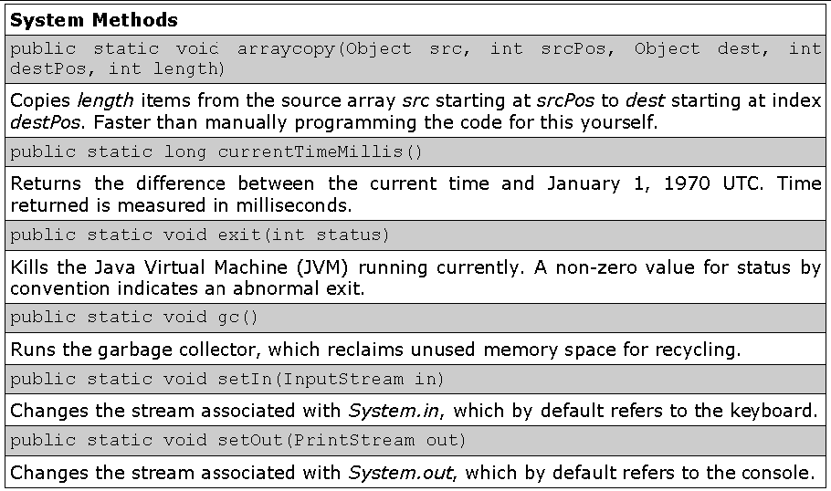
The System Class: Methods
© 2013 Capgemini - All rights reserved
Notes:
Ver 1.0 © 2006 Capgemini - All rights reserved

Slide 31
The System Class: Example
import java.io.IOException;
public class Elapsed {
public static void main(String[] args) throws IOException {
long lngStart, lngEnd = 0;
System.out.println("Timing a for from 0 to 1,000,000");
/time a for loop from 0 to 1,000,000
lngStart=System.currentTimeMillis();
for(int j=0;j<1000000;j++)
lngEnd = System.currentTimeMillis();
System.out.println("Elapsed time : " + (lngEnd-lngStart));
}
}
Output:
Timing a for from 0 to 1,000,000 Elapsed time: 78
© 2013 Capgemini - All rights reserved
Notes:
Ver 1.0 © 2006 Capgemini - All rights reserved

Slide 32
Recap (Hot Keywords)
Math.cos
Integer.parseInt
System.out.print
StringBuilder
Immutable
Append
String
© 2013 Capgemini - All rights reserved
Notes:
Recap – tips : To make it further lighter, many facilitator ask participant that they were allow to leave only if they will answer say 12 correct answers out of 15 questions. And then produce all recaps as questions.
© 2006 Capgemini - All rights reserved

Slide 33
Thank You For Your Time
Notes:
© 2006 Capgemini - All rights reserved

